Slide 1
Azure Workshop
Azure Fundamentals

Slide 2

Instructor
Mohd Mishal
Clouds Solution Architect
MCT since 2006
MCSA, MCSE, MCITP, MCSA
Azure, SCCM, O365
Computer Engineer UIUC

Slide 3
Workshop Schedule
Day 1
Introduction to Cloud
Compute Instances
Virtual Networks
Platform as a service Virtual Machines
The Basics of Azure

Slide 4
Workshop Schedule
Day 2
Web Apps
Site Recovery and Back Up
Active Directory in Azure
Diving Deep into Azure

Slide 5
Agenda
Time | Topic
8:30 AM | Registration and Breakfast
8:45 AM | Welcome remarks
9:00 AM | Introduction to Cloud
9:15 AM
10:15 AM | Compute Instances
10:30 AM
11:30 AM | Virtual Networks
12:30 PM | Platform as a Service Virtual Machines
1:30 PM
2:45 PM
4:00 PM

Slide 6
Cloud Computing

Slide 7

Overview of cloud computing
Characteristics of cloud-computing solutions:
On-demand self-service
Broad network access
Resource pooling
Rapid elasticity
Measured service
Advantages of cloud computing:
Access to a broad range of managed services
Minimized or eliminated capital expenses
Lowered operational expenses
Usage-based billing model
Improved agility
Notes:
10979D
1: Getting started with Microsoft Azure

Slide 8
Cloud-computing models
A public cloud is an infrastructure, platform, or application service that a cloud service provider delivers for access and consumption by the public
A private cloud is a privately owned and managed cloud that offers benefits similar to those of a public cloud, but is designed and secured for use by a single organization
A hybrid cloud is a technology that binds two separate clouds—public and private—together for the specific purpose of obtaining resources from both
Notes:
10979D
1: Getting started with Microsoft Azure

Slide 9
Types of cloud services
Microsoft Azure
Office 365, Dynamics, VS Online, Intune, etc.
Windows Server + System Center (Server Platform)
Windows Server + Hyper-V +
Microsoft Azure
Physical
Virtual
IaaS
PaaS
SaaS
Notes:
Microsoft Office 365 is a good example of a SaaS offering. It is a fully functional, ready-to-use collection of software applications that are available from the cloud.
Azure Web apps and Azure SQL Database are good examples of a PaaS service. Both offer a platform for building custom applications and solutions, but do not require management at the operating-system level.
Note: Azure SQL Database sometimes is described as a Database-as-a-Service offering. This term represents a database-specific subset of PaaS solutions. Similarly, you might encounter terms such as Disaster Recovery-as-a-Service in reference to Azure Site Recovery or Identity-as-a-Service in relation to Azure Active Directory.
Azure Virtual Machines constitute a good example of an IaaS solution. They allow you to host Windows and Linux servers in the cloud and retain full control over their operating systems.
10979D
1: Getting started with Microsoft Azure

Slide 10
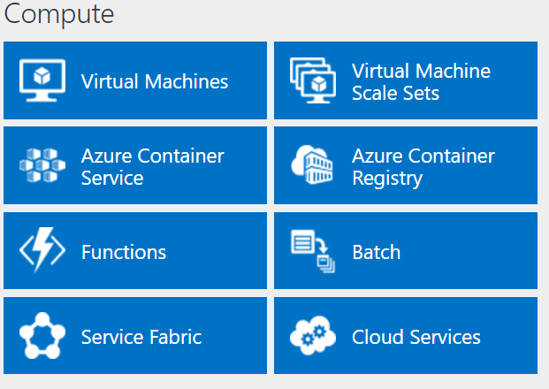
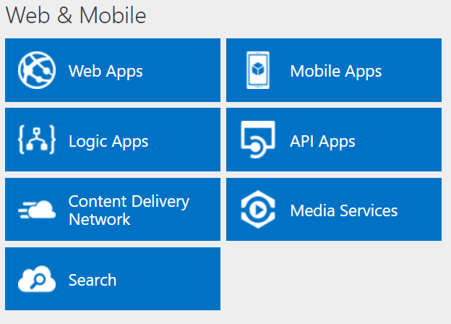
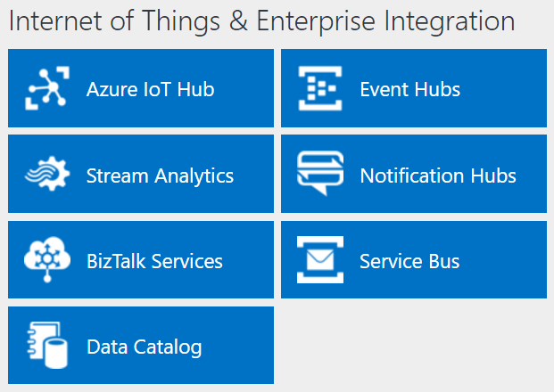
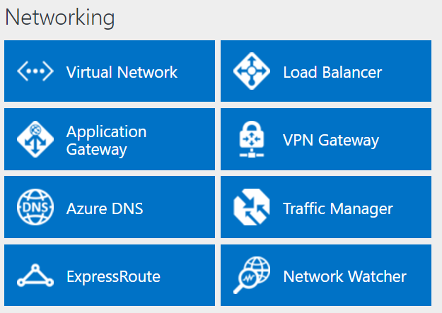
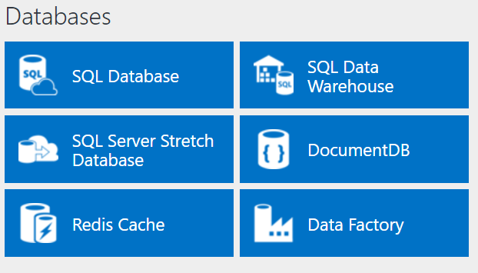
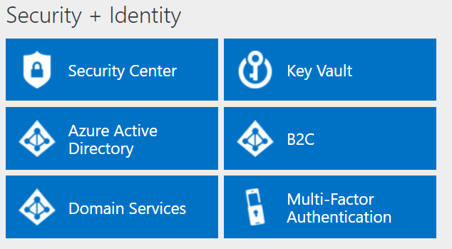
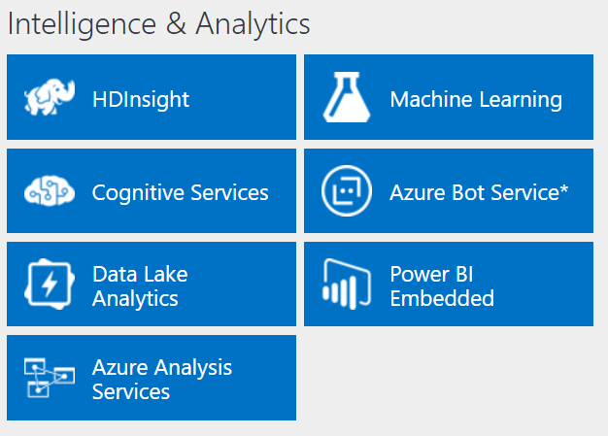
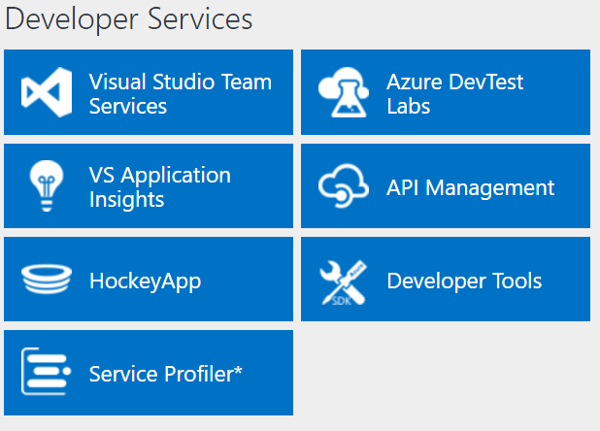
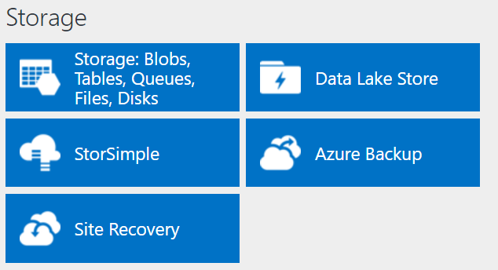
Azure services
http://azureplatform.azurewebsites.net/
* Preview Services
Notes:
Preview Version 1.7 (2017-04-20)

Slide 11
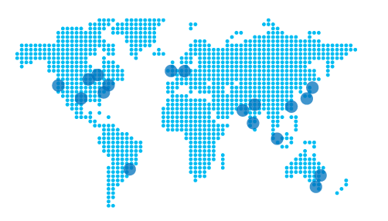
Azure services
Azure services allow you to:
Deploy and operate cloud-based applications
Host workloads in the cloud
Integrate cloud services with an on-premises infrastructure
Datacenter placement follows the principle of pairing
Notes:
10979D
1: Getting started with Microsoft Azure

Slide 12
Azure Vocabulary
Account
App Service app
Azure Resource Manager
Resource group
Region
Subscription
Storage account
Fault Domain
Update Domain
Notes:
https://docs.microsoft.com/en-us/azure/azure-glossary-cloud-terminology#storage-account

Slide 13
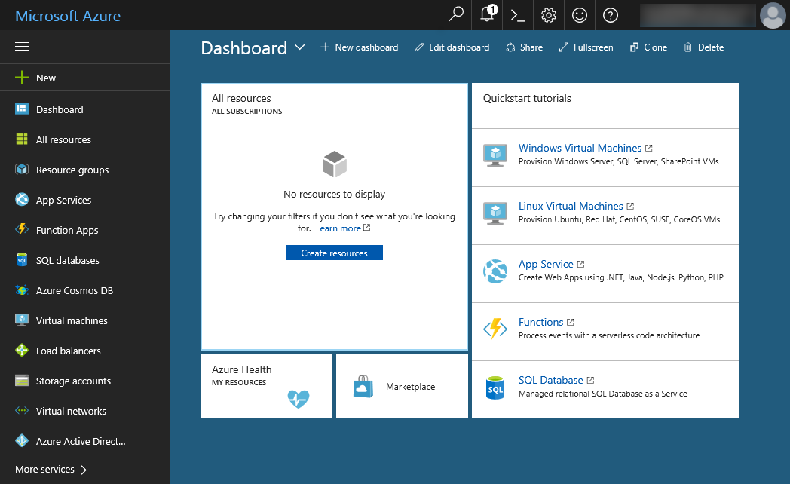
The Azure portal
Notes:
we will be sunsetting the Azure classic portal on January 8, 2018
10979D
1: Getting started with Microsoft Azure

Slide 14
Navigating the Azure portals

Slide 15
Client tools
Windows PowerShell with Azure PowerShell modules:
Run commands and scripts to manage Azure from Windows, Linux, OS X
Azure CLI:
Run commands and scripts to manage Azure from Windows, Linux, OS X
Visual Studio with Azure SDK for .NET:
Build solutions targeting Azure
Azure Cloud Shell:
Use command line interactively directly from within the Azure portal
Notes:
Describe different ways of interacting with Azure resources.
10979D
1: Getting started with Microsoft Azure

Slide 16
Azure pricing
No upfront costs
No termination fees
Pay only for what you use
Per minute billing
Notes:
10979D
1: Getting started with Microsoft Azure

Slide 17
Azure billing and support options
The most common Azure billing options include:
Pay-As-You-Go
Buy from a Microsoft Reseller
Enterprise agreements
Notes:
10979D
1: Getting started with Microsoft Azure

Slide 18
https://github.com/MicrosoftLearning/10979-MicrosoftAzureFundamentals/blob/master/Instructions/10979D_LAB_01.md
Estimated Time: 20 minutes

Slide 19
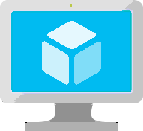
Compute Instances

Slide 20
Creating and configuring VMs
What are Azure VMs? Create a VM by using the Azure portal Demonstration: Create a VM from the Azure portal by using an Azure Marketplace image Creating a VM from an Azure Resource Manager template Demonstration: Creating a VM from an Azure Resource Manager template Configuring VM availability Demonstration: Deploying VMs into an availability set by using the Azure portal Configuring an operating system by using VM extensions Connecting to a VM Demonstration: Connecting to a VM
Overview of virtual hard disks Overview of managed disks Azure VMs disk mobility Configuring storage in Windows and Linux VMs Demonstration: Configuring disks
Notes:
10979D
3: Virtual machines in Microsoft Azure

Slide 21
What are Azure VMs?
Use Azure VMs to:
Extend your datacenter to increase agility
Migrate your workloads from on-premises datacenters or from other cloud providers
Implement production, test, or development
Key differences when using Azure VMs:
Currently no support for Generation 2 Hyper-V VMs
Read-only VM console access
Cost calculated on per-minute basis:
Does not apply when VM is stopped (deallocated)
Does not include VM disks in Azure Storage
Notes:
Explain the main benefits of deploying VMs in Azure. Discuss some common scenarios. In addition, explain the differences between on-premises Microsoft Hyper-V VMs and VMs in Azure. Lastly, mention the method of calculating Azure VM charges.
There are additional slides for this topic.
10979D
3: Virtual machines in Microsoft Azure

Slide 22
Azure VM sizes
General purpose:
balanced CPU-to-memory ratio
A0-A7, Av2 series, D series, Dv2 series, DS series, DSv2 series
Compute optimized:
high CPU-to-memory ratio
Fs and F series
Memory optimized:
high memory-to-CPU ratio
D, Dv2, DS, DSv2, M, G, and GS series
Storage optimized:
high-performance disk I/O
Ls series
GPU:
Graphic Processing Unit support
NV and NC series
High performance compute:
fastest CPUs and optional high-throughput RDMA
H series and A8-A11
Notes:
Describe the categories of Azure VM sizes.
10979D
3: Virtual machines in Microsoft Azure

Slide 23

Azure VM Sizes
A
D
Dv2
G
Av2
Lowest Price
SSD Storage Fast CPUs
New generation of D family VMs
High memory and
Large SSDs
New A-Series
F
NC
NV
H
L
SAP
Compute Intensive
NVIDIA GPUs
K80 Compute
NVIDIA GPUs
M60 Visualization
Fastest CPU
IB Connectivity
Large SSDs
SAP Large Instances
Soon
Soon
Soon
Soon
ND
NCv2
Dv3
Ev3
Deep Learning
NVIDIA P40s
New gen of NC
NVIDIA P100s
New generation of D family
High memory

Slide 24
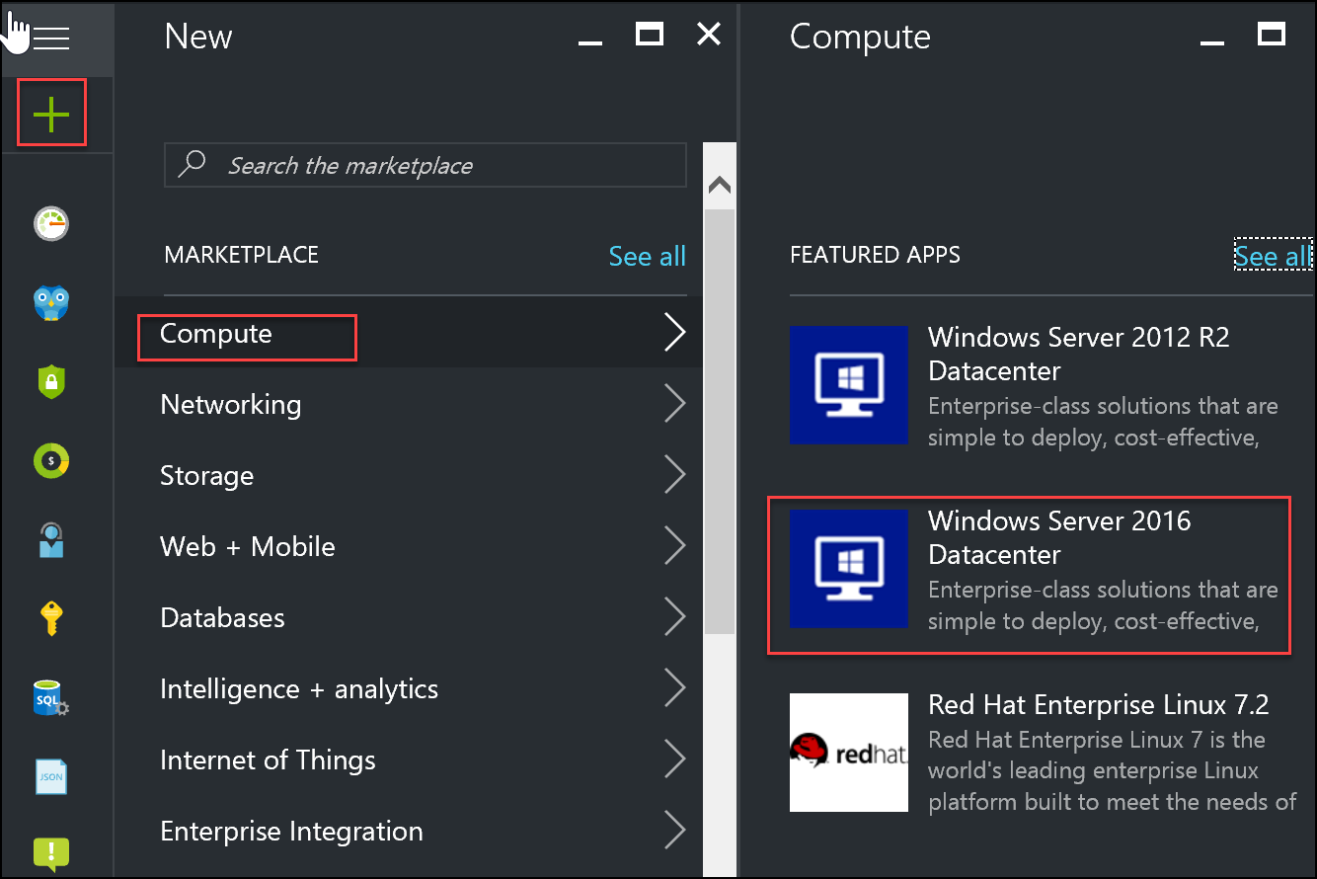
Using the Azure portal to create virtual machines
Notes:
The Azure Portal based experience:
VM name
VM disk type
User name and password
User name and SSH public key (Linux only)
Subscription
Resource group
Location
VM size
Storage (managed or non-managed disks)
Storage account (non-managed disks only)
Virtual network and subnet
Public IP address
Network security group
Extensions
Monitoring and the corresponding Diagnostics storage account
20533D
3: Implementing virtual machines

Slide 25
Create a VM from the Azure portal by using an Azure Marketplace image
Notes:
https://docs.microsoft.com/en-us/azure/virtual-machines/windows/quick-create-portal
https://docs.microsoft.com/en-us/azure/virtual-machines/linux/quick-create-portal

Slide 26
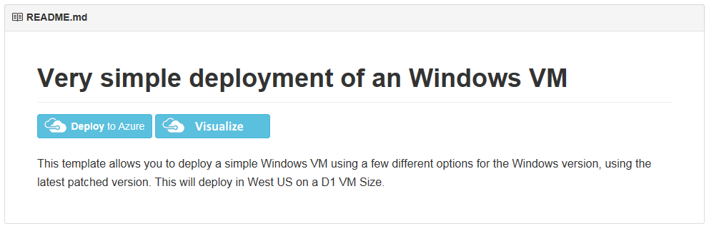
Creating a VM from an Azure Resource Manager template
Azure PowerShell:
New-AzureRmResourceGroupDeployment
Azure CLI:
az group deployment create
Azure portal:
New > Compute > Template deployment
GitHub (redirects to the Azure portal):
https://github.com/Azure/azure-quickstart-templates
Notes:
Describe the different methods of deploying Azure Resource Manager templates.
10979D
3: Virtual machines in Microsoft Azure

Slide 27
Creating a VM from an Azure Resource Manager template
https://github.com/Azure/azure-quickstart-templates/tree/master/101-vm-simple-windows
Notes:
High level demonstration steps
From the classroom VM, start Internet Explorer and browse to https://github.com/Azure /azure-quickstart-templates/tree/master/101-vm-simple-windows.
On the Very simple deployment of a Windows VM page, click Deploy to Azure.
On the Custom deployment blade, specify the following:
Subscription: Your subscription
Resource group: Create new
New resource group name: 10979D03-DemoRG03
Location: Azure region closest to the classroom location
Admin Username: Student
Admin Password: Pa55w.rd1234
Dns Label Prefix: Unique string consisting of lower-case letters and digits
Windows OS Version: 2016-Datacenter
Click I agree to the terms and conditions stated above.
Select the Pin to dashboard check box.
Click Purchase.
Note the Deployment started message in the notification area at the top of the page.
Do not wait for the deployment to complete. Continue with the next topic.

Slide 28
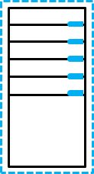
Configuring VM availability
Fault Domain 0
Fault Domain 1
Fault domain 0
Fault domain 1
Fault domain 2
Update
domain 0
Update
domain 4
Update
domain 3
Update
domain 1
Update
domain 0
Update
domain 4
Update
domain 2
Update
domain 1
Update
domain 0
Update
domain 3
Update
domain 2
Update
domain 1
Notes:
Use this slide to illustrate the distribution of VMs across fault domains and update domains.
There is an additional slide for this topic.
10979D
3: Virtual machines in Microsoft Azure

Slide 29
VM scaling
Vertical scaling:
Change individual VM size
Horizontal scaling:
Change number of VMs in the same availability set
On demand or scheduled
Azure Resource Manager model:
VM scale sets: automatically provisioned VMs
Classic model:
Preprovisioned VMs
Notes:
10979D
3: Virtual machines in Microsoft Azure

Slide 30
Deploying VMs into an availability set by using the Azure portal
https://docs.microsoft.com/en-us/azure/virtual-machines/windows/tutorial-availability-sets

Slide 31
Configuring an operating system by using VM extensions
VM Agent:
Included automatically in Marketplace images
You can add it to your custom VM images
VM extensions:
Background Info extension (Windows)
Azure VM Access extension for Windows and Linux
Chef Client and Puppet Enterprise Agent (Windows and Linux)
Custom Script extension for Windows and Linux
DSC extension for Windows and Linux
Azure Diagnostic extension for Windows and Linux
Docker extension (Linux)
Microsoft Antimalware extension (Windows)
Notes:
Briefly review the functionality that each extension provides. Explain that this is just a subset of all VM extensions available for Azure VMs.
10979D
3: Virtual machines in Microsoft Azure

Slide 32
Connecting to a VM
Windows VMs:
RDP:
User based authentication
Generate .rdp file from the portal or via Windows PowerShell
Incoming connections:
Allowed by default (when using the Azure Portal)
Windows Firewall rule
Network Security Group rule
Linux VMs:
SSH:
User based or certificate based authentication
Use an SSH client
Incoming connections:
Allowed by default (when using the Azure Portal)
Network security group rule
Notes:
Describe the two primary methods of connecting to Windows and Linux Azure VMs.
10979D
3: Virtual machines in Microsoft Azure

Slide 33
Connecting to a VM
https://docs.microsoft.com/en-us/azure/virtual-machines/windows/connect-logon

Slide 34
Configuring disks
Overview of virtual hard disks Overview of managed disks Azure VMs disk mobility Configuring storage in Windows and Linux VMs Demonstration: Configuring disks
Notes:
10979D
3: Virtual machines in Microsoft Azure

Slide 35
Overview of virtual hard disks
Azure VM
C:\
operating system disk
D:\
Temporary disk
(contents can be
lost)
F:\Data disks
Azure blob
Notes:
Remind the students about virtual disks. Most of them will probably know about the virtual disks that Hyper‑V uses. If that is the case, you can focus on virtual disks that Microsoft Azure supports.
Explain the basics of Azure VM disk structure and how Azure stores VM disks.
10979D
3: Virtual machines in Microsoft Azure

Slide 36
Overview of managed disks
Non-managed disks:
Up to 200 Storage accounts per region
Up to 40 disks per Standard storage account
Storage accounts for VMs in the same availability set might be in the same stamp
A custom image in the same Storage account as VM disks
Managed disks:
Up to 10,000 disks per region
Storage account performance limits not relevant
Disks of VMs in the same availability set in different stamps
A custom image in the same region
Notes:
Compare and contrast nonmanaged disks and managed disks.
10979D
3: Virtual machines in Microsoft Azure

Slide 37
Azure VMs disk mobility
Azure virtual disk files:
.vhd format (.vhdx not supported)
Fixed type (dynamic not supported)
4-TB maximum size (use multidisk volumes if needed)
Azure virtual disk mobility:
Upload and download
Add-AzureRmVHD and Save-AzureRmVHD
az storage blob upload and az storage blob download
Attach and detach
Add-AzureRmVmDataDisk and Remove-AzureRmVMDataDisk
azure vm disk attach-new and azure vm disk detach
Azure Portal
Import/Export service (for larger disk sizes)
Azure virtual disk files copy and snapshot:
Managed and non-managed disks (full snapshots only)
Notes:
Describe cross-premises and Azure-only scenarios that involve disk copy, attach, detach, and snapshot operations.
10979D
3: Virtual machines in Microsoft Azure

Slide 38
Configuring storage in Windows and Linux VMs
The multi-disk management tools as on-premises:
Server Manager (Windows Storage Spaces)
Windows PowerShell (Windows Storage Spaces)
LVM (Linux)
mdadm (Linux)
Multi-disk volumes considerations:
Aggregate I/O throughput
Support for volumes larger than 4-TB disk size limit
Maximum number of data disks depends on VM size
Notes:
Depending on the students’ preference, focus on Storage Spaces–based Windows multidisk configuration or on Logical Volume Manager (LVM)/mdadm multidisk configuration on Linux.
Point out that, in either case, the steps to configure a multidisk volume are identical to those for on-premises computers.
10979D
3: Virtual machines in Microsoft Azure

Slide 39
Configuring disks
Notes:
High level demonstration steps
From the classroom VM, start Internet Explorer and browse to the Azure portal. If prompted, sign in by using the Microsoft account that is the Service Administrator of your Azure subscription.
Navigate to the 10979D03DemoVM1 blade.
Add two standard storage managed disks, each with a size of 128 GB.
Switch back the Remote Desktop session to 10979D03DemoVM1.
On 10979D03DemoVM1, create a new simple volume by using both disks with default settings.
Wait until the volume is fully formatted.
Close the RDP connection.
Delete all resource groups that you created in this module.
Close all open windows on the classroom VM.
Preparation Steps
Make sure you completed the previous demonstrations in this module.

Slide 40
https://github.com/MicrosoftLearning/10979-MicrosoftAzureFundamentals/blob/master/Instructions/10979D_LAB_03.md
Estimated Time: 30 minutes

Slide 41
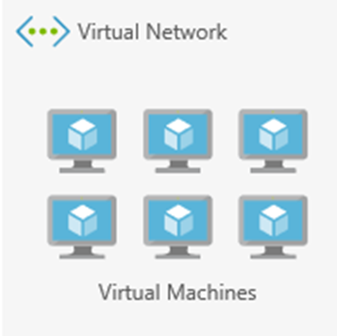
Virtual Networks

Slide 42
Virtual networks
What are virtual networks? Determine the need for virtual networks Virtual network capabilities
Creating and configuring Azure virtual networks Demonstration: Creating a virtual network Azure networking features
Overview of Azure Load Balancer Creating an Azure load balancer Demonstration: Creating an Azure load balancer
Notes:
10979D
5: Creating and configuring virtual networks

Slide 43
What are virtual networks?
Logical network boundary
Provided as a managed service:
Automatic routing
Built-in DNS name resolution
Support for customization
Private IP address space
Divided into one or more IP subnets
Notes:
10979D
5: Creating and configuring virtual networks

Slide 44
Determine the need for virtual networks
Deployment types:
Cloud-only deployments
Cross-premises deployments
Deployments without virtual network dependency
Virtual networks and Microsoft cloud resources:
Azure VMs (ARM) – must reside on a virtual network
Azure cloud services and Azure VMs (classic) – can reside on a virtual network
Azure Web apps – can connect to a virtual network via P2S VPN
Azure SQL Database, Azure AD – no direct connectivity to a virtual network
Notes:
Review different deployment types in the context of virtual network dependencies. Describe the most common Microsoft cloud resources and their integration (or lack thereof) with Azure virtual networks.
10979D
5: Creating and configuring virtual networks

Slide 45
Virtual network capabilities
IP address allocation:
Dynamic (default) — support for static IP address assignments
Traffic routing:
User defined routes and forced tunneling
Traffic filtering:
Network Security Groups
Notes:
Describe different capabilities available on Azure virtual networks.
10979D
5: Creating and configuring virtual networks

Slide 46
IP Addresses
Public and Private
4096 Private IP addresses per vnet
60 Dynamic Public IPs
20 Static Public IPs
Public IP addresses can be dynamic or static.
Dynamic IP address is not allocated until associated resource is created/started.
Dynamic IP Released when stop/delete resource.
Static IP address allocated immediately. Released only when it is deleted.
Use with
Virtual machines (VM)
Internet-facing load balancers
VPN gateways
Application gateway
Azure Datacenter IP Ranges: https://www.microsoft.com/en-us/download/details.aspx?id=41653
https://docs.microsoft.com/en-us/azure/virtual-network/virtual-network-ip-addresses-overview-arm#public-ip-addresses

Slide 47
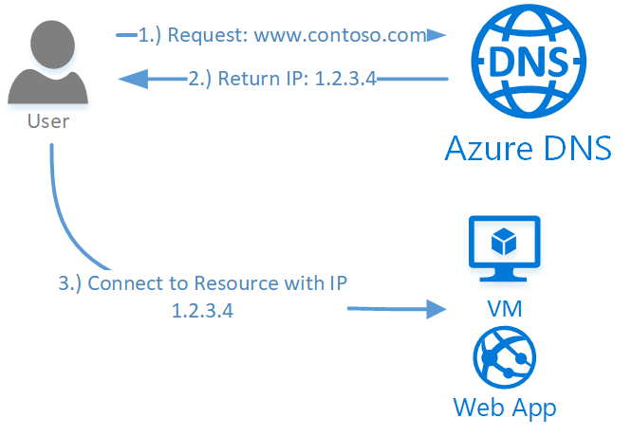
DNS name resolution
Azure Service for managing Public DNS (99.99% SLA)
Integrates with Azure Management Services
Controlled with Role Based Access Control
100 DNS Zones per subscription
5000 Record sets per zone
20 Records per record set
https://docs.microsoft.com/en-us/azure/dns/dns-overview

Slide 48
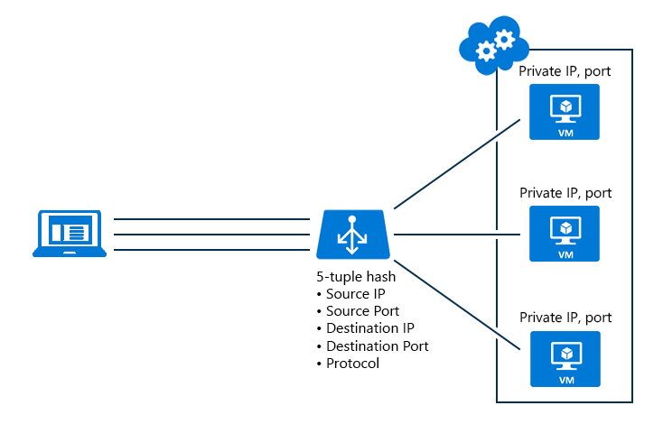
Load balancing
Notes:
Internal and External
10979D
5: Creating and configuring virtual networks

Slide 49
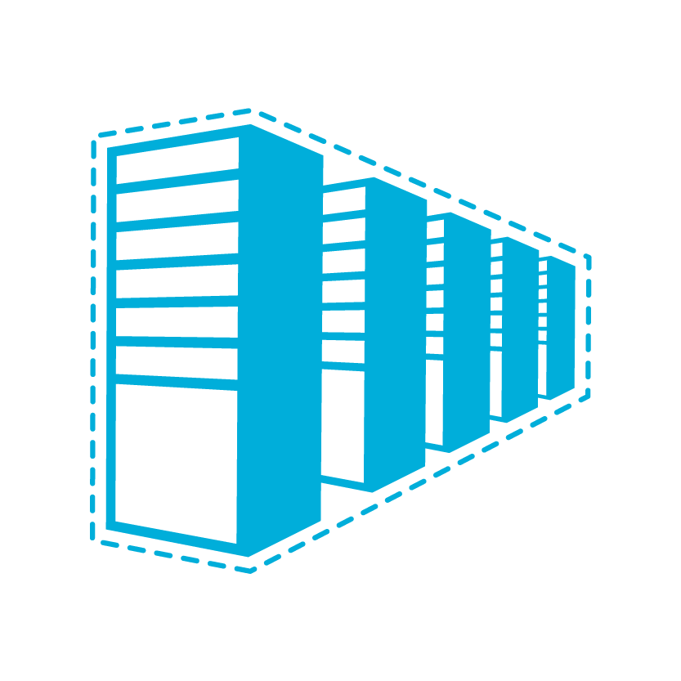


Virtual network connectivity
Cloud
Customer
Segment and workloads
Consumers
Access over public IP
DNS resolution
Connect from anywhere
Internet Connectivity
Developers
POC Efforts
Small scale deployments
Connect from anywhere
Secure point-to-site connectivity
SMB, Enterprises
Connect to Azure compute
Secure site-to-site
VPN connectivity
SMB & Enterprises
Mission critical workloads
Backup/DR, media, HPC
Connect to Microsoft services
ExpressRoute private connectivity
Notes:
Virtual network connectivity:
Cross-premises: P2S VPN, S2S VPN, ExpressRoute
Cross-VNet – VNet peering, VNet-to-VNet

Slide 50
Creating and configuring Azure virtual networks
Private IP address space:
Standard IP address ranges (RFC 1918):
10.x.x.x
172.16.x.x – 172.31.x.x
192.168.x.x
Avoid overlap with on-premises and other Azure virtual networks
IP Subnets:
The smallest supported size is /29
Use them to separate groups of virtual machines:
Security (Network Security Groups)
Individual tiers of multi-tier applications
Name resolution:
Azure DNS
Custom DNS
Notes:
Point out that Azure DNS in this case represents the Azure internally provided name resolution rather than the Azure DNS service.
10979D
5: Creating and configuring virtual networks

Slide 51
Creating a virtual network
Notes:
The main tasks for this exercise are as follows:
Create virtual networks by using Azure Portal
Task 1: Create a virtual network by using the Azure portal
From MIA-CL1, start Microsoft Edge, go to http://portal.azure.com, and then, if prompted, sign in to the Azure portal as the Service Administrator of your Azure subscription.
From the Azure portal, create a new virtual network by using the following settings:
Name: labVNet1
Address space: 10.0.0.0/16
Subnet name: Subnet1
Subnet address range: 10.0.0.0/24
Subscription: Your Azure subscription
Resource group: Create new
New resource group name: 10979D05-LabRG01
Location: Azure data center where you can deploy Azure VMs, closest to the location of your classroom
Pin to dashboard: Select the checkbox
From the Azure portal, create a new virtual network by using the following settings:
Name: labVNet2
Address space: 10.1.0.0/16
Subnet name: Subnet1
Subnet address range: 10.1.0.0/24
Subscription: Your Azure subscription
Resource group: Use existing 10979D05-LabRG01
Location: Azure data center where you can deploy Azure VMs, closest to the location of your classroom
Pin to dashboard: Select the checkbox
Task 2: Configure VNet peering by using the Azure portal
In the Azure portal, navigate to the labVNet1 blade.
From the labVNet1 blade, create a VNet peering with the following settings:
Name: labVNet1-labVNet2
Deployment model: Resource manager
Subscription: Your Azure subscription
Virtual network: labVNet2
Allow virtual network access: Enabled.
Allow forwarded traffic: Disabled
Allow gateway transit: Disabled
Use remote gateways: Disabled
In the Azure portal, navigate to the labVNet2 blade.
From the labVNet2 blade, create a VNet peering with the following settings:
Name: labVNet2-labVNet1
Deployment model: Resource manager
Subscription: Your Azure subscription
Virtual network: labVNet1
Allow virtual network access: Enabled.
Allow forwarded traffic: Disabled
Allow gateway transit: Disabled
Use remote gateways: Disabled

Slide 52
Azure networking features
Public IP addresses
Traffic Manager:
DNS-based load balancing
Any public, DNS-resolvable endpoint:
Azure
On-premises
Third-party hosting providers
Four routing algorithms:
Performance
Failover
Weighted
Geographic
Notes:
Describe Azure networking features that do not depend directly on Azure virtual networks.
10979D
5: Creating and configuring virtual networks

Slide 53

Overview of Azure Load Balancer
443
LOAD BALANCER
443
443
443
VM
VM
VM
Notes:
The slide depicts an end-user computer located at the top of the slide connecting from the Internet via port 443 to a load balancer. Azure Load Balancer distributes incoming traffic across three virtual machines (located at the bottom of the slide) to the port 443. Point out that the load balancer directs the traffic to only one of the VMs if the connection parameters, such as source and target IP addresses and ports, remain the same.
10979D
5: Creating and configuring virtual networks

Slide 54
Creating an Azure load balancer
Frontend IP configuration
Assign frontend IP(s)
Configure backend pool
Create load balancing rules:
Name
Protocol
Port
Backend port
Backend pool
Probe
Session persistence
Idle timeout
Floating IP
Create Inbound NAT rules:
If needed
Inbound NAT rules
LB rules (IP/port mapping)
probes
probes
Backend pool
Notes:
Describe the components of an Azure load balancer.
10979D
5: Creating and configuring virtual networks

Slide 55
Creating an Azure load balancer
https://docs.microsoft.com/en-us/azure/load-balancer/load-balancer-get-started-ilb-arm-portal

Slide 56
https://github.com/MicrosoftLearning/10979-MicrosoftAzureFundamentals/blob/master/Instructions/10979D_LAB_05.md
Estimated Time: 30 minutes

Slide 57
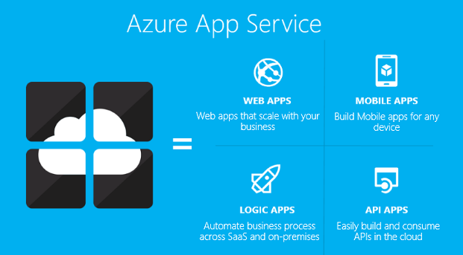
Platform as a Service

Slide 58
Platform as a Service
Creating and deploying PaaS cloud services
Notes:
10979D
4: Web Apps and cloud services

Slide 59
What are cloud services?
Worker role
instances
PaaS
cloud service
Web role
instances
Notes:
Begin this topic by summarizing the IaaS virtual machines and App Services hosting models, and then compare them to the PaaS cloud services hosting model. Remember that the PaaS cloud services hosting model is likely to be new to most students and not analogous to anything they have run on-premises. Make sure that students are familiar with multitier applications.
Emphasize to the students that:
Developers must write PaaS cloud service applications specifically for Azure. This is unlike apps designed to run on virtual machines or in web apps, both of which can be hosted in other cloud platforms or in on-premises environments.
The modular nature of cloud services, with web roles and worker roles, enables flexible scalability. Therefore, you should consider them for multitier applications with a highly variable demand.
To qualify for the Azure service level agreements (SLAs) with 99.95 percent uptime, you must create at least two instances of every role in your cloud service. These instances run in separate Azure fault domains and upgrade domains. Therefore, point out that it is essential to discuss the architecture of the cloud service with developers before deployment.
Mention briefly the emerging hosting models, including microservices and containers, focusing in particular on Azure Service Fabric, Docker, Windows Server Containers, and Azure Container Service.
10979D
4: Web Apps and cloud services

Slide 60
Creating and deploying a cloud service
PaaS
cloud
service
Package file
Configuration file
Visual Studio Team Services
Visual Studio
Azure portal
Notes:
Consider combining the demonstration at the end of this lesson with this topic as you present it.
10979D
4: Web Apps and cloud services

Slide 61
Scaling a cloud service
Horizontal scaling:
Changing the number of instances of a role
Manual or automatic
Automatic scaling based on combination of:
Schedule
Recurring
Fixed date
Performance
Role instance (CPU, network I/O, disk I/O)
Other Azure resources (for example, Azure Storage queue)
Vertical scaling:
Changing the size of instances of a role
Requires modifying the .csdef file
Notes:
Consider combining the demonstration at the end of this lesson with this topic as you deliver it.
10979D
4: Web Apps and cloud services

Slide 62
Creating, deploying, and scaling a cloud service
Create a new cloud service
Configure the cloud service
Scale the cloud service
https://docs.microsoft.com/en-us/azure/load-balancer/load-balancer-get-started-ilb-arm-portal

Slide 63
https://github.com/MicrosoftLearning/10979-MicrosoftAzureFundamentals/blob/master/Instructions/10979D_LAB_04.md
Exercise 2
Estimated Time: 15 minutes

